Slide 1

DeepStereo: a low-cost flexible camera system (for marine snow stereo imaging)
Yohan Sequeira -MBARI Bio Inspired Lab
Under mentorship of: Kakani Katija, Joost Daniels, Paul Roberts
Collaborating with: Melissa Omand, URI

Slide 2
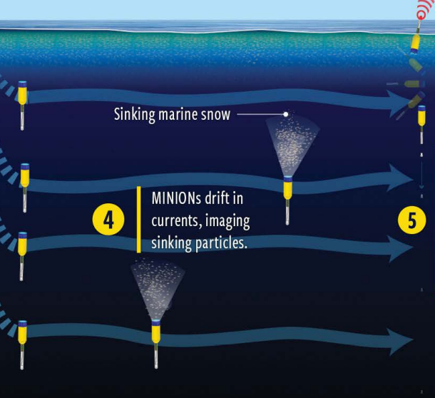
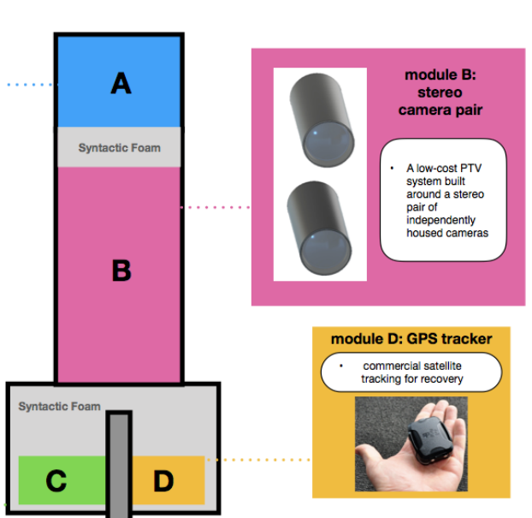
Minion float system - stereo pair

Slide 3
Selection criteria
The system must be able to image particles between 100um and 2mm, moving between 1e-3 m/s and 2e-2 m/s.
The system would be able to take images such that particle velocities can be extracted.
The system should operate up to depths of 500m.
There should be some modularity/flexibility to the system to allow mounting changes.
Low cost (<$500)

Slide 4
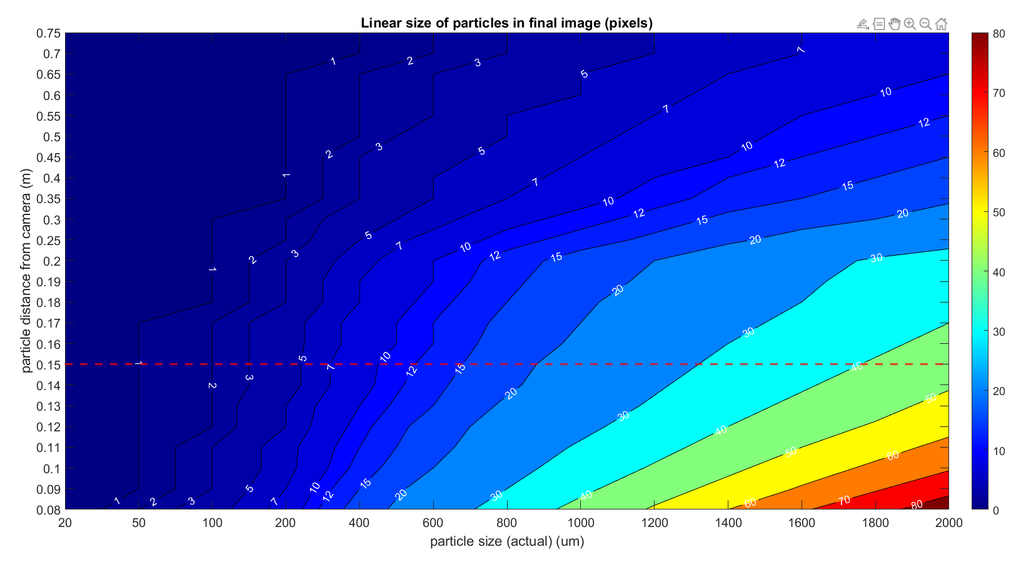
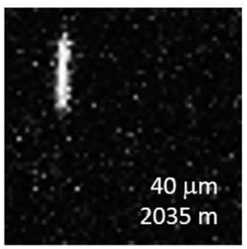
Criteria 1 : Imaging small particles
Particle size (actual)
Linear size (pixels) ~60
(Focal distance)✖(Image Height)✖(Particle Size)
Linear size =
(Object distance)✖(Sensor height)

Slide 5
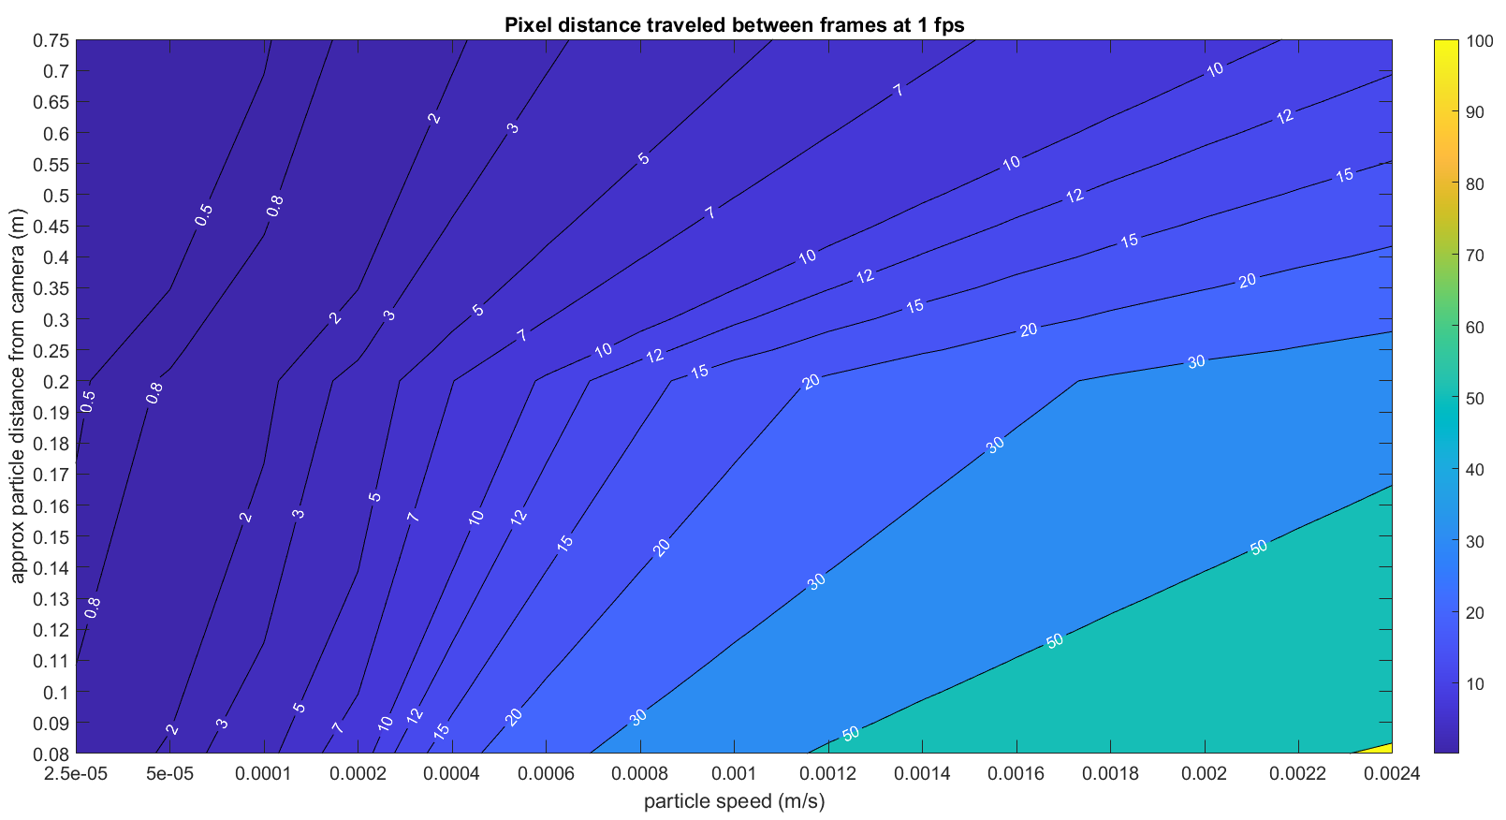
Criteria 1 : Imaging small particles

Slide 6


Slide 7
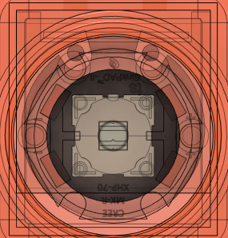
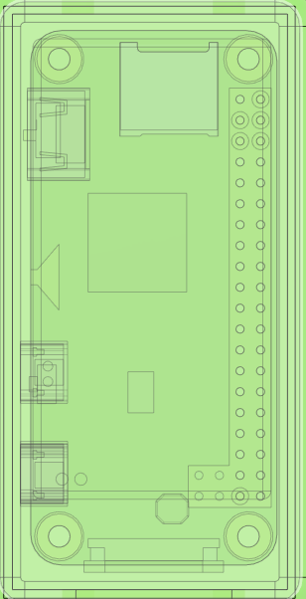
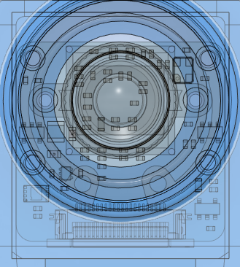
Proposed hardware - version 1
Gnd
Gnd
LED and LED Driver
LED and LED Driver
V+
V+
LED control GPIO
LED control GPIO
Primary
Raspberry Pi Zero and Battery
RasPi GPIO Synchronization
Secondary
Raspberry Pi Zero and Battery
Camera and Lens
Camera and Lens
Ribbon Cable
Ribbon Cable

Slide 8
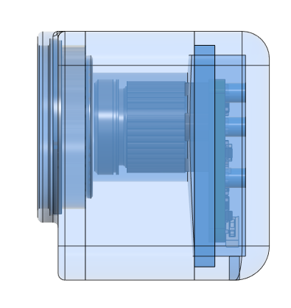
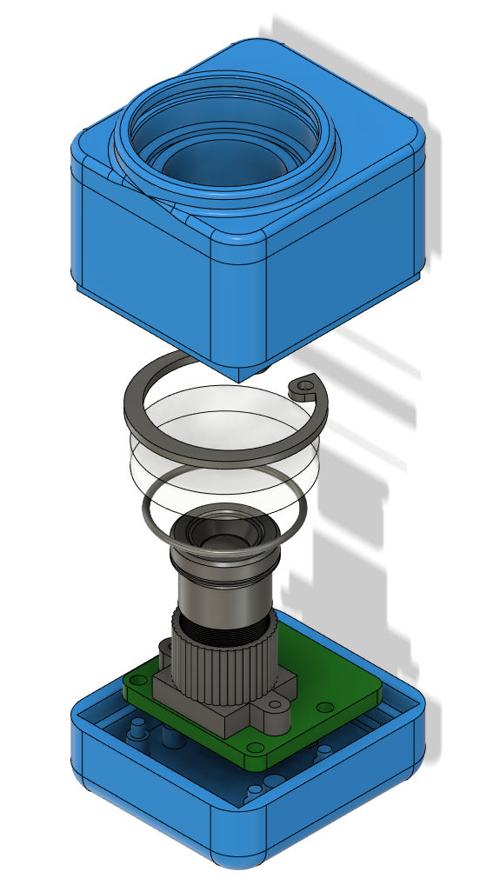
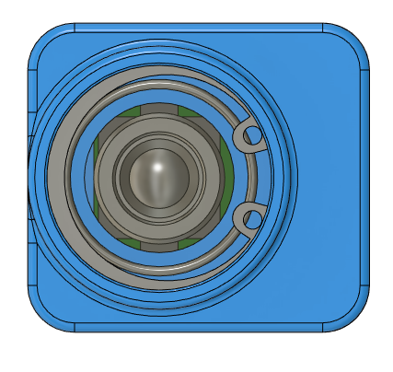
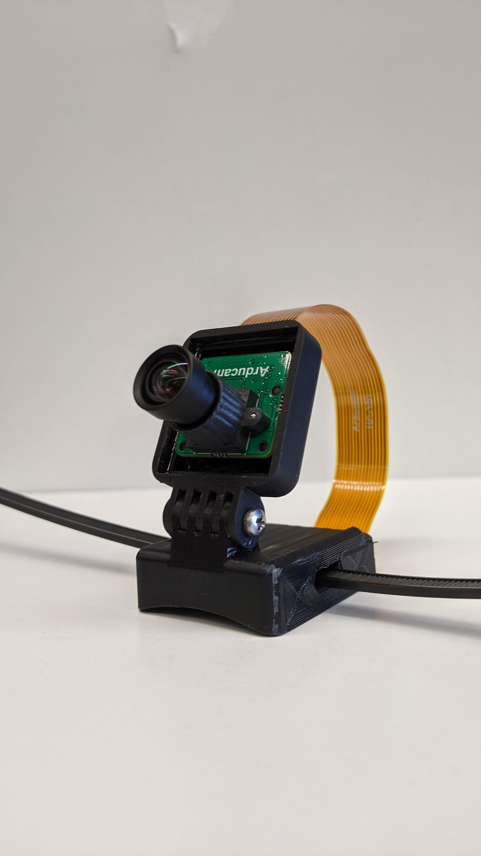
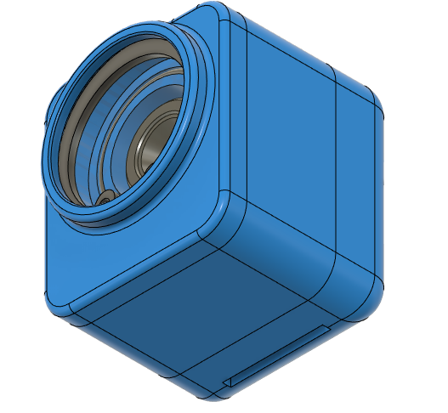
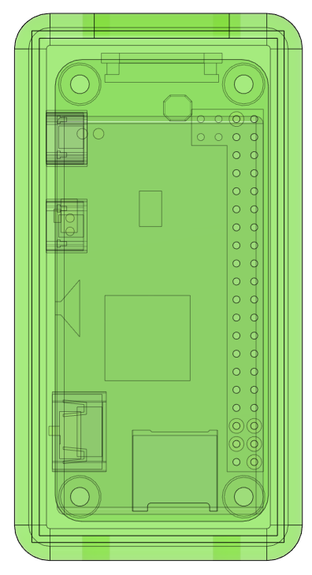
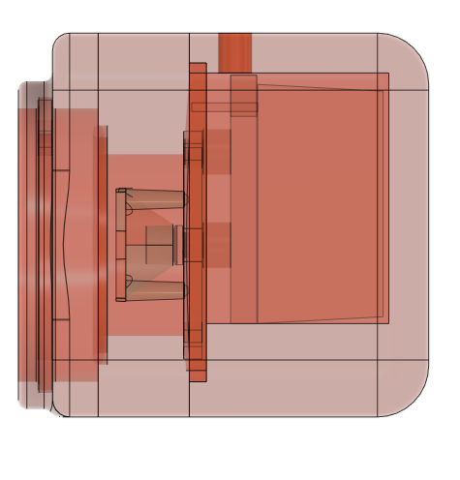
Criteria 3: Pressure shielding
7. Camera Internals
9. Camera Views
10. Camera in Housing
Resin Cover
Acrylic
Air
Epoxy
Retainer Ring
Top View
Acrylic Port
8. Other Housings
O-Ring
Camera
Resin Base
Angled View

Slide 9
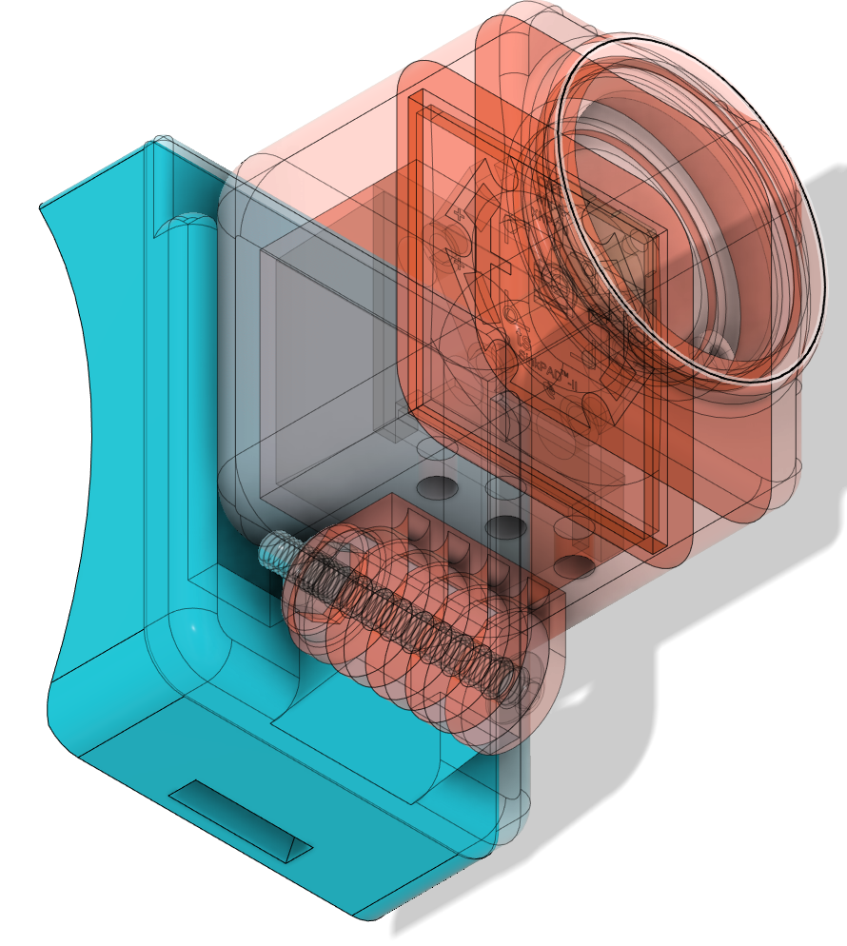
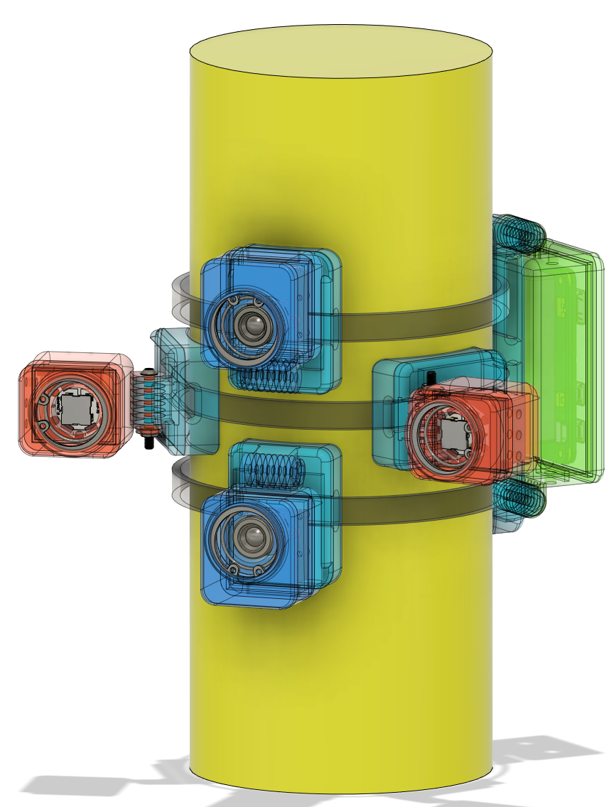
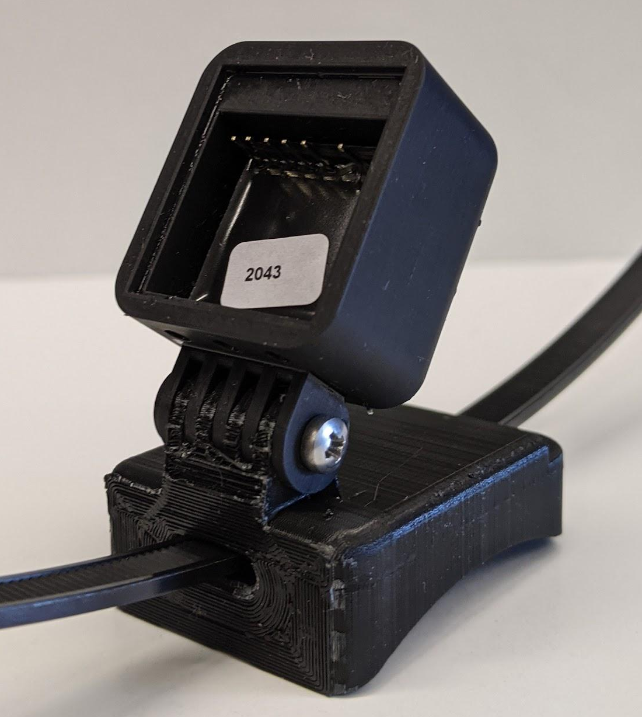
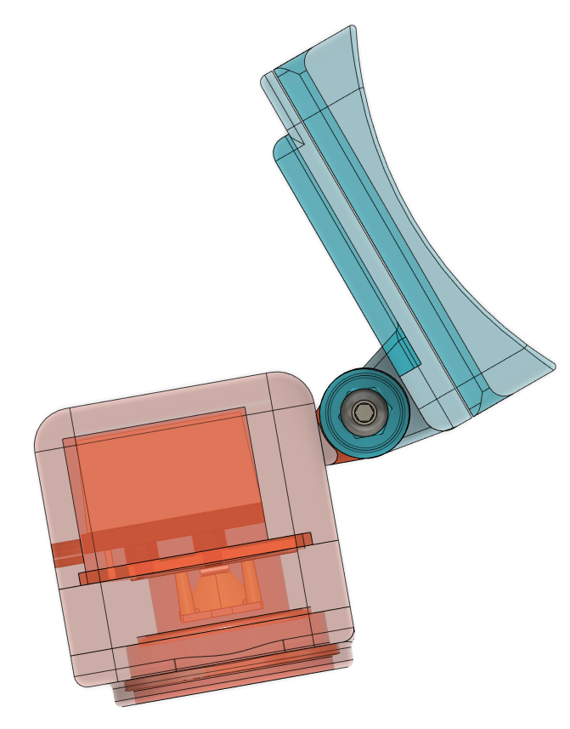
Criteria 4: Flexible Mounting
11. Mounting System
12. Side View
13. Light (Driver) in Housing
12. Side View
Hinge

Slide 10
Software Block Diagram Overview
Delay for wake
Turn on light and delay
Primary
Primary
Primary
GPIO signal
GPIO signal
Wake signal
Secondary
Secondary
Secondary

Slide 11
Preliminary Images
Stereo image here
Some kind of table?? Showing when the frame was captured

Slide 12
Summary and Future Work
Summary:
The DeepStereo system provides an inexpensive, configurable system to capture stereo images of marine snow particles.
Future Work:
Movement of float can cause inaccurate velocity measurement.
Synchronization is required between Raspberry Pi’s to capture accurate images.
Epoxy potting does not allow for manipulation of components.
Battery capacity in current design may limit imaging time.

Slide 13
Future directions
Strengths - attractive features:
Flexible mounting system allows many options for camera/light placement.
Low cost (<$500) allows for widespread deployment.
Resin printing allows for easier manufacturing/sourcing or materials.
Modular design allows for easy replacement of parts.
Weaknesses - things to improve:
Multiple housings require separate construction.
Movement of float can cause inaccurate velocity measurement.
Part failures require disposal of entire housing due to epoxy containment.
Separate Raspberry Pi boards require synchronization to capture stereo images.

Slide 14
Thank You for your attention.
References:
[1] Bochdansky, A., Clouse, M. & Herndl, G. Dragon kings of the deep sea: marine particles deviate markedly from the common number-size spectrum. Sci Rep 6, 22633 (2016).
[2] Boyd, P.W., Claustre, H., Levy, M. et al. Multi-faceted particle pumps drive carbon sequestration in the ocean. Nature 568, 327–335 (2019).
[3] Omand, M.M., Govindarajan, R., He, J. et al. Sinking flux of particulate organic matter in the oceans: Sensitivity to particle characteristics. Sci Rep 10, 5582 (2020).
[4] Brennan T. Phillips, Stephen Licht, Karla S. Haiat, Jake Bonney, Josh Allder, Nicholas Chaloux, Russell Shomberg, Tim J. Noyes, DEEPi: A miniaturized, robust, and economical camera and computer system for deep-sea exploration, Deep Sea Research Part I: Oceanographic Research Papers, Volume 153, 2019, 103136, ISSN 0967-0637.
Acknowledgement:
The MBARI Summer Internship Program is generously supported through a gift from the Dean and Helen Witter Family Fund and the Rentschler Family Fund in memory of former MBARI board member Frank Roberts (1920-2019) and by the David and Lucile Packard Foundation.

Slide 15
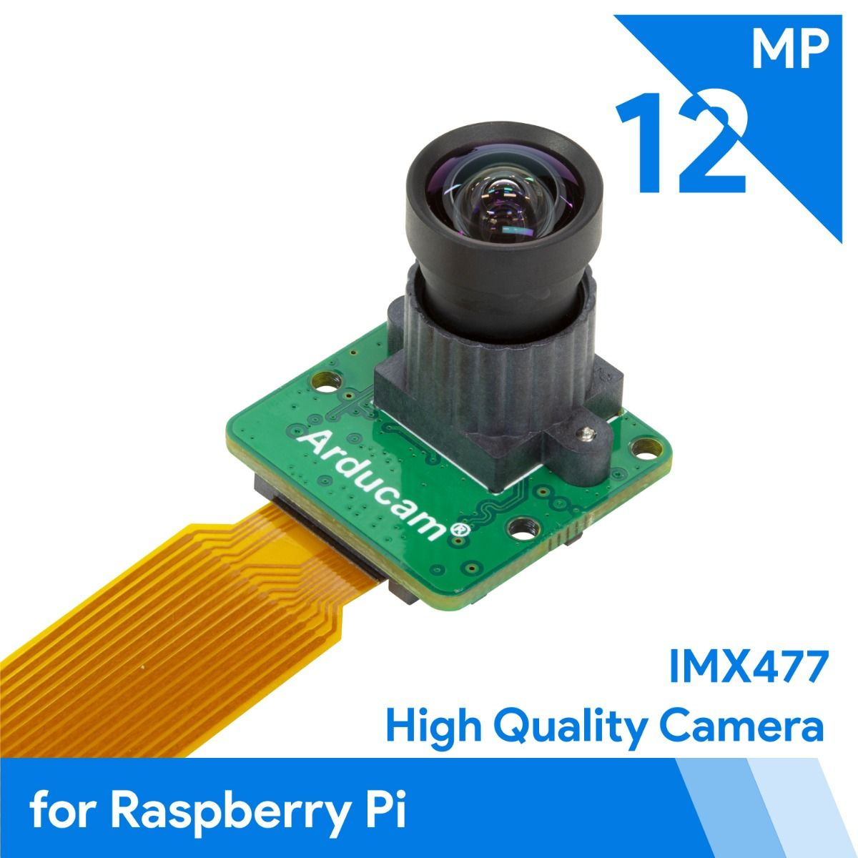
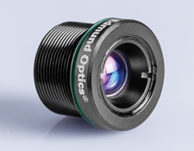
What exact camera should be chosen?
Camera Parameters - Arducam IMX477
Name | Value
Camera Fov | 47 degrees
Camera Focal Distance | 5.4 mm
Camera Resolution | 4056x3040
Image Sensor Size (diagonal) | 7.9 mm
Frame Rate | 1 fps
Camera F-Stop | 8
Working distance | 15 cm

Slide 16
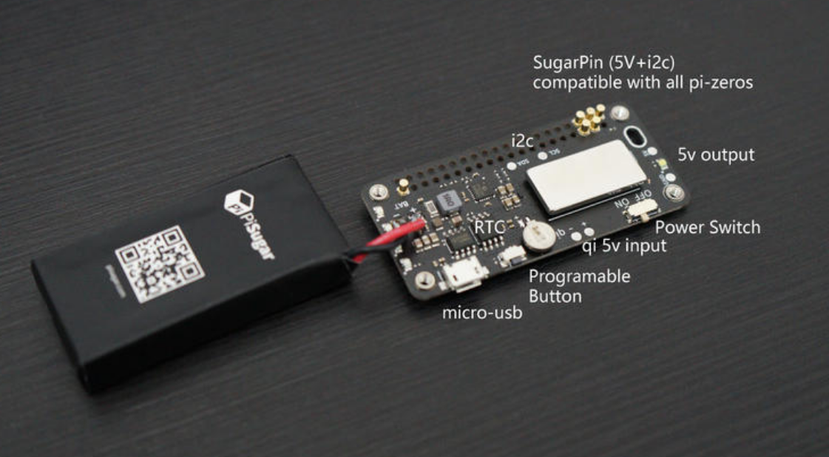
Power Board

Slide 17
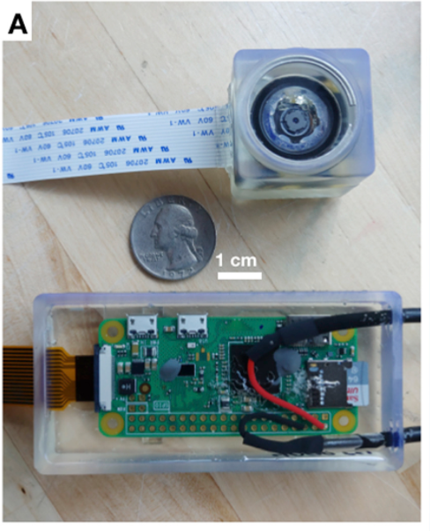
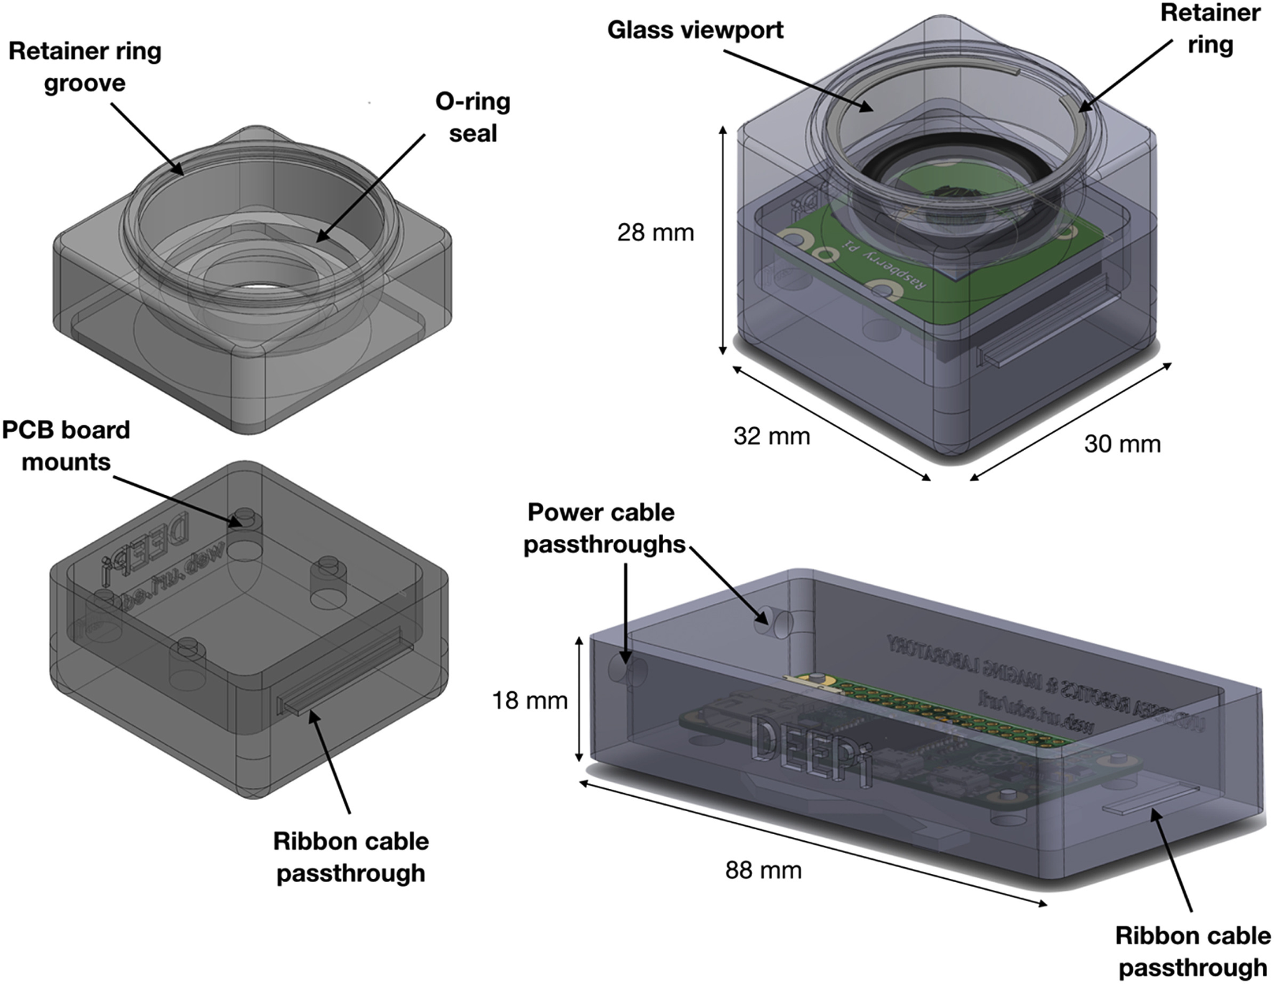
*Specs: 8MP, 5500m depth, ~$200 materials, tested 1500m for 6 hr

